Slide 1

Data Career Kickstarter
With Microsoft excel & Power bi

Slide 2
Course Outline
a
Module 1 – Introduction to Data Analytics ( 2 hrs )
Module 2 – Excel for Data Analysts ( 8 hrs )
Module 3 – ETL with Power Query ( 4 hrs )
Module 4 – Data Modeling Concepts ( 4 hrs )
Module 5 – Data Analysis in Power BI with DAX ( 8 hrs )
Module 6 – Data visualization and report design ( 4 hrs )
Module 7 – Deploy and maintain Power BI Assets in Power BI Service ( 2 hr )
Module 8 – Introduction to SQL ( 4 hrs )

Slide 3

Module 2 – Excel for Data Analysts
We will learn
Data Types, Formatting Data, Worksheets
Sorting and filtering data
Formulas and Functions
Pivot Tables
Text, Date Time and Logical functions
Nested logic formulas
Lookup functions (VLOOKUP, INDEX)
Bonus : Common issues in workplaces with excel

Slide 4
Session 1 – Excel basics
Data types, formatting,
worksheet management

Slide 5
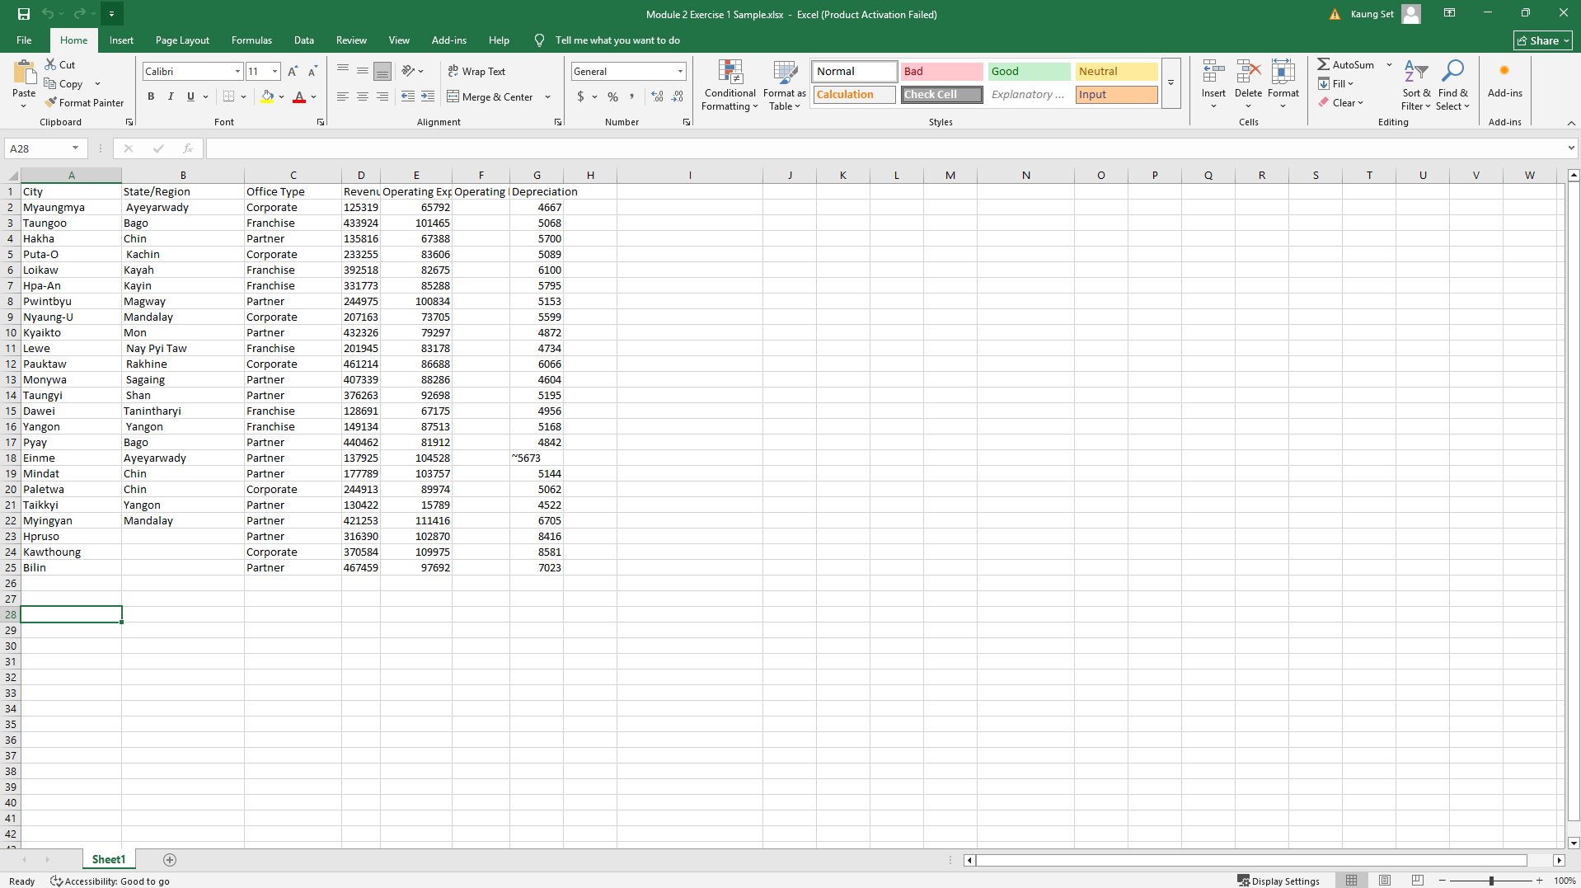
Excel UI Walkthrough

Slide 6
Data Types in Excel
Values used for calculations (e.g., 123, 45.67, -10).
Can be formatted as Currency, Percentage, Date/Time, etc.
Numbers
Any sequence of characters not recognized as a number, date, or formula.
Important: Numbers entered as text (e.g., leading zeros like 007, or numbers with special characters like 12-345) cannot be directly used in calculations.
Text
Excel stores dates and times as serial numbers.
January 1, 1900 = 1; January 2, 1900 = 2, and so on
Date&Time
Boolean
Logical values.
TRUE or FALSE. Used in logical tests and functions
Boolean
Why it matters? Data type affects sorting, filtering, and formulas!

Slide 7
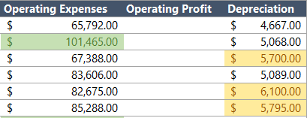
Basic Formatting
1. Number Formatting
2. Font Formatting
General: Default
Number: Controls decimal places, comma separators
Currency/Accounting: Adds currency symbols, aligns decimals
Percentage: Displays as a percentage.
Date/Time: Various date/time display formats
Font Type, Size, Bold, Italic, Underline.
Font Color.
3. Alignment
4. Borders & Fill
Horizontal: Left, Center, Right
Vertical: Top, Middle, Bottom
Wrap Text: Makes text fit within cell by increasing row height
Merge & Center: Combines cells and centers content (use with caution for data analysis!)

Slide 8
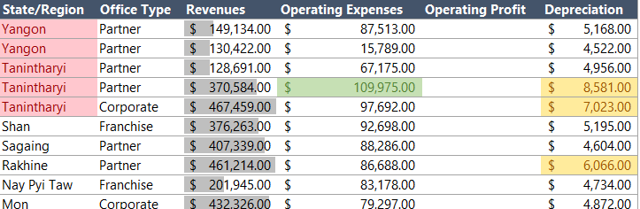
Conditional Formatting
Duplicate values
Data Bars
Greater than x
Top Values
Great for quickly spotting trends, outliers, or important values

Slide 9
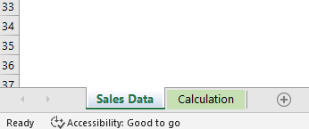
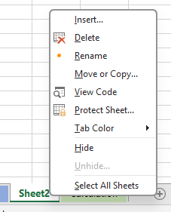
Working with Work Sheets
Key Worksheet Management Actions:
Insert New Sheet: Click the + button next to existing tabs or Home tab > Cells group > Insert > Insert Sheet.
Rename Sheet: Double-click the sheet tab, or right-click > Rename.
Move/Copy Sheet: Drag and drop the tab, or right-click > Move or Copy... (check "Create a copy").
Delete Sheet: Right-click the sheet tab > Delete (caution: irreversible!).
Tab Color: Right-click the sheet tab > Tab Color.
Grouping Sheets: Select multiple sheets (Ctrl + Click or Shift + Click) to perform actions on all selected sheets simultaneously (e.g., entering data, applying formatting).

Slide 10
Exercise 1 – Formatting
Task 1 – Format the numbers in the “Sales” sheet to their appropriate formatting
Task 2 – Format column headers to be more structured and professional
Task 3 – Highlight duplicated values in State/Region column
Task 4 – Find a way to visualize the Revenues column so that user can compare between cities easily
Task 5 – Highlight Operating Expenses that exceeds 100,000 $
Task 6 – Highlight Top 10 highest depreciation amounts

Slide 11
Session 1 Recap
Your foundation is built!
We explored the Excel Interface and learned efficient Navigation.
We understood different Data Types and their impact on analysis
We mastered Basic Formatting to make data readable and professional
We introduced Conditional Formatting for dynamic highlighting
We learned to Manage Worksheets for better organization.

Slide 12
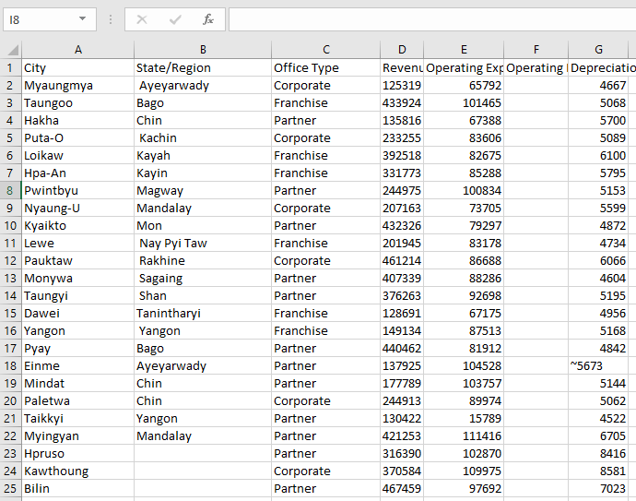
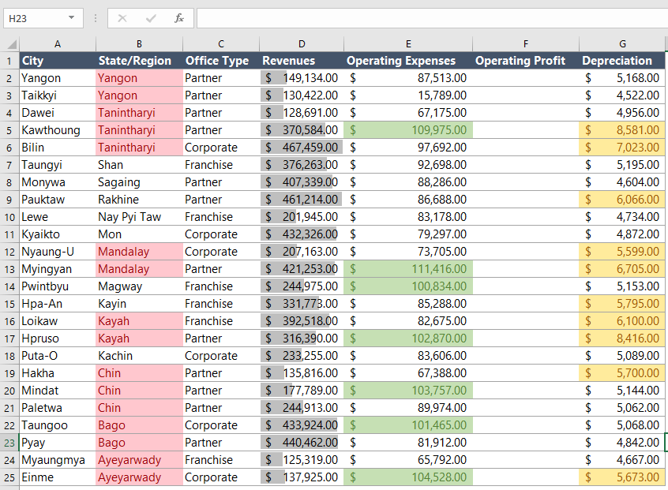
Session 1 Recap
Started from here…
Now we are here…

Slide 13
Session 2 – Organizing and Calculating Data - Sorting, Filtering, Formulas, and Functions

Slide 14
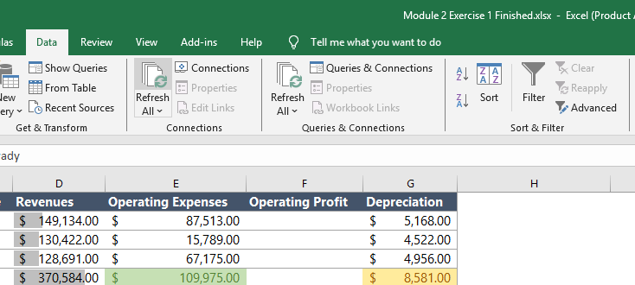
Sorting Data
Types of Sorts:
Alphabetical: A to Z, Z to A (for text).
Numerical: Smallest to Largest, Largest to Smallest (for numbers).
Chronological: Oldest to Newest, Newest to Oldest (for dates/times).
Custom Lists: Sort by your own defined order (e.g., Low, Medium, High; Jan, Feb, Mar).
It's crucial for finding trends, identifying highs/lows, or simply making data easier to read.

Slide 15
Filtering Data
Text Filters: Equals, Does Not Equal, Contains, Begins With, Ends With. You can also select specific items from a list.
Number Filters: Greater Than, Less Than, Between, Top 10, Above/Below Average.
Date Filters: Equals, Before, After, Between, Next Week, This Month, Year to Date, All Dates in the Period.
Search Box: Quickly type to find specific text or numbers within the filter dropdown.
Focusing on relevant information.

Slide 16
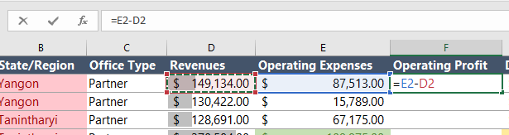
Calculations with Formulas
What is a formula?
All formulas start with an equals sign ( = )
Formulas are expressions that perform calculations, return information, or modify cell contents.

Slide 17
Calculations with Formulas
Basic Arithmetic Operators
Order of Operations
+ (Addition)
- (Subtraction)
* (Multiplication)
/ (Division)
^ (Exponentiation)
Parentheses () (expressions inside are calculated first)
Exponents ^
Multiplication * and Division / (from left to right)
Addition + and Subtraction - (from left to right)

Slide 18
Calculations with Formulas
Understanding Cell References
Relative (A1): Changes when copied.
Absolute ($A$1): Stays fixed when copied.
Mixed ($A1, A$1): Partially fixed when copied.

Slide 19
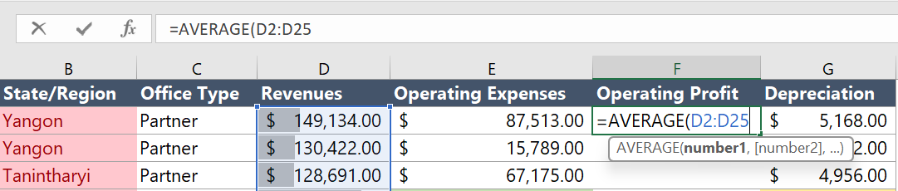
Introduction to Functions
Function syntax: FUNCTIONNAME(argument1, argument2, ...)
What is a function?
Pre-defined formulas by excel that perform specific calculations.

Slide 20
SUM, AVERAGE, COUNT, MIN, MAX.
Introduction to Functions
Basic Functions
SUM
AVERAGE
COUNT
MIN
MX

Slide 21
SUM, AVERAGE, COUNT, MIN, MAX.
Exercise 2 – Formula and Functions
Task 1 – Sort the data to show highest to lowest Revenues
Task 2 – Use a formula to calculate “Operating Profit” (Profit = Revenue – Expenses)
Task 3 – Calculate values of Total Revenues, Average Operating Expenses, Highest Revenues, Lowest Revenues, and number of cities in the report
Task 4 – Create a new column that shows total revenues converted to MMK
Task 5 – Filter the data to only show “Partner” office type

Slide 22
Session 2 Recap
You're Mastering Your Data!
We learned how to Sort data for effective organization.
We mastered Filtering to focus on specific data subsets.
We built Formulas with arithmetic operators and understood the Order of Operations
We learned about Cell References (relative, absolute)
We started using common Functions (SUM, AVERAGE, COUNT, MIN, MAX) for quick analysis

Slide 23
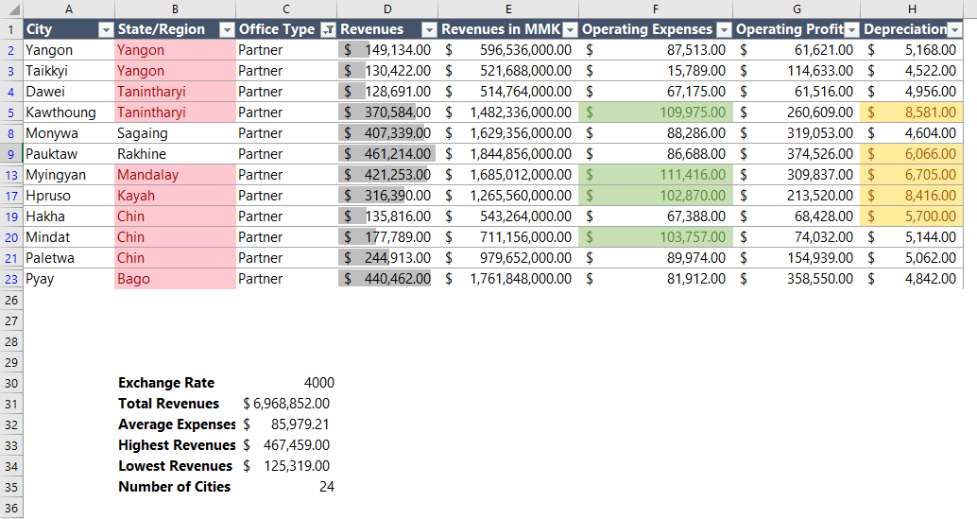
Session 2 Recap
Started from here…
Now we are here…

Slide 24
Session 3 – Data Cleaning in Excel
Text, Date/Time, and Logical Functions

Slide 25
Text Functions
TRIM
(text)
Removes extra spaces from text, except for single spaces between words.
LEFT
(text, num_chars)
Extracts a specified number of characters from the beginning (left) of a text string
RIGHT
(text, num_chars)
Extracts a specified number of characters from the end (right) of a text string.
CONCATENATE
(text1, text2,…)
Joins several text strings into one.
LEN
(text)
Returns the number of characters in a text string.
UPPER, LOWER, PROPER
(text)
Change text to all uppercase, all lowercase, or proper case (first letter capitalized).
Text functions operate on cells containing text, or numbers treated as text

Slide 26
Exercise 3 – Text Functions
Task 1 – Fill the “PaymentType” Column with the data from transaction type, but only take the text before the comma ( , ) sign.
Task 2 – Clean up white spaces and fill the data in “AccountLevel” column
Task 3 – Change city names into the style that only has the initial character in capital letter
Task 4 – Combine “ProductCategory” and “Channel” under “CategoryandChannel” column with a ( _ ) in between.

Slide 27
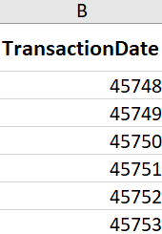
Date/Time Functions
Serial Numbers
for Calculations
Excel stores dates as sequential serial numbers, starting from January 1, 1900, as 1.
Times are stored as fractions of a day.
This serial number system allows you to perform arithmetic operations on dates (e.g., Date1 - Date2 gives days between).

Slide 28
Date/Time Functions
TODAY()
Returns the current date (updates automatically).
NOW()
Returns the current date and time (updates automatically).
DAY
(date_serial)
Extracts the day of the month (1-31).
MONTH
(date_serial)
Extracts the Month number (1-12).
YEAR
(date_serial)
Extract the year.
WEEKDAY
(date_serial)
Returns the day of the week (1-7).
Remember to change the date data locale into English (United Kingdom)

Slide 29
Exercise 4 – Date Functions
Task 1 – In cell B1, fill the current date as the reporting date
Task 2 – Find out how many days each supplier take to fill the stock after getting the order in Lead Time column
Task 3 – Extract Order Year and fill for each supplier
Task 4 – Extract Order Month and fill for each supplier

Slide 30
Break Time – (5 Minutes)

Slide 31



Logical Functions
Uses comparison operators:
= (Equals)
> (Greater Than)
< (Less Than)
>= (Greater Than or Equal To)
<= (Less Than or Equal To)
<> (Not Equal To)
What is a logical function?
3 Logical Functions in Excel
IF
It checks if a condition is TRUE or FALSE and returns one value if true, and another if false.
IFERROR
IFNA

Slide 32
Exercise 5 – Logical Functions
Task 1 – Add a new column called “Order Period” , and fill the cells with “H1” if Order Month is within the first half of the year and “H2” if Order Month is in the second half
Task 2 – Add a new column called “Lead Time Category” , and fill the cells with “Normal” if the lead time is less than 20 days and “Slow” if the lead time is higher than 20 days
Task 3 – Format the new columns to be consistent with “Lead Time” , “Order Year” and “Order Month” columns

Slide 33
Nested IF Functions
The AND Function:
AND(logical1, [logical2], ...)
Returns TRUE only if ALL of its arguments are TRUE.
Example: AND(Sales > 10000, Region = "North")
When One IF Isn't Enough!
Sometimes your decision needs to check multiple criteria simultaneously.
Excel's AND and OR functions help you build complex logical tests within an IF statement.
The OR Function:
OR(logical1, [logical2], ...)
Returns TRUE only if ANY of its arguments are TRUE.
Example: OR(Unit Sold < 50, Product Status = “Discontinued”)

Slide 34
Nested IF Functions
Combining IF with AND/OR:
=IF(AND(condition1, condition2), value_if_true, value_if_false)
=IF(OR(condition1, condition2), value_if_true, value_if_false)
Multiple Checks , Two Output!
Nested IF Statements:
When you have more than two possible outcomes (e.g., A, B, C instead of just True/False).
You put another IF function inside the value_if_false (or value_if_true) argument of the first IF.
Syntax: =IF(condition1, outcome1, IF(condition2, outcome2, outcome3))
Multiple Checks , Multiple Outputs!

Slide 35
Conditional Aggregation
SUMIF
Only sums values that meet your condition.
COUNTIF
Perfect for tracking how many times something appears.
AVERAGEIF
Only averages values that meet your condition.

Slide 36
Exercise 6 – Nested IF and SUMIF
Task 1 – Use an IF function to create a formula in cell H7. This formula must check the subtotal amount in column G7. If the amount is greater than $10,000 then the formula should display the result 10%. If the amount is less than $10,000, then the formula should display the result as 0.
Task 2 – Create a formula in cell L7 using the Nested IF function to calculate the delivery charges. The delivery charges are mentioned in Cell C2 to D4.
Task 3 – Create a formula in cell M7 that adds together the total (excluding the delivery amount) in K7 and the delivery charge in L7.
Task 4 – Create a SUMIF formula in cells H2, H3 and H4 that calculates a sales total (excluding delivery) for Region A, B and C respectively

Slide 37
Break Time – (5 Minutes)

Slide 38
Look Up Functions
VLOOKUP
INDEX MATCH
Can only search left to right
Breaks if you insert or delete columns
Slower on large datasets
Can search both left and right
Doesn’t break with structural changes
More efficient and faster for large datasets

Slide 39
Exercise 7 – VLOOPUP and INDEX + MATCH
Task 1 – Search and insert Cost per Units values for each Category using VLOOKUP
Task 2 – Search and insert Cost per Units values for each Category using INDEX + MATCH

Slide 40
Session 3 Recap
Your Excel toolkit for Data Analyst is growing!
We learned to clean and manipulate text using Text Functions like TRIM, LEFT, RIGHT, CONCAT.
We explored Date and Time Functions to perform duration calculations and extract components.
We started making categorization according to conditions using the IF Function.
We built Complex Logic with IF and Nested IF.
We used Conditional Aggregations (SUMIF, COUNTIF, AVERAGEIF) for precise data summarization
We mastered VLOOKUP and INDEX MATCH for powerful data retrieval.

Slide 41
Session 4 – Advanced Formulas
Nested Logic, Lookup Functions
And Pivot Tables
Bonus : Excel Common Issues and trouble shooting

Slide 42
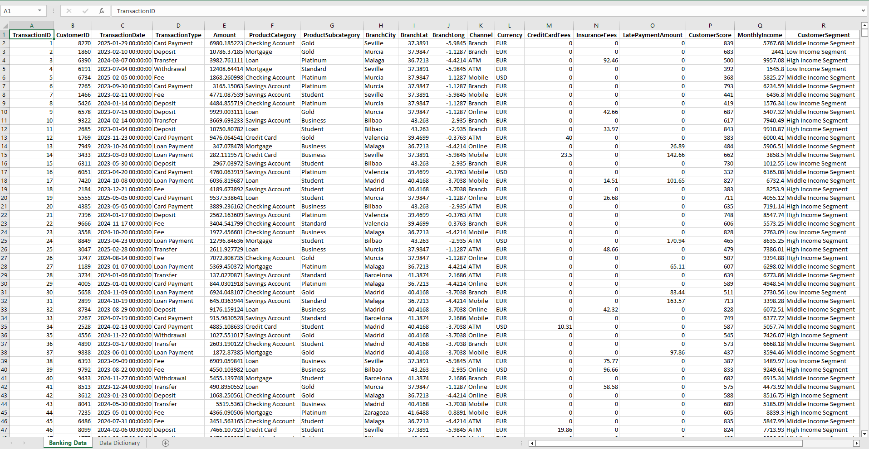
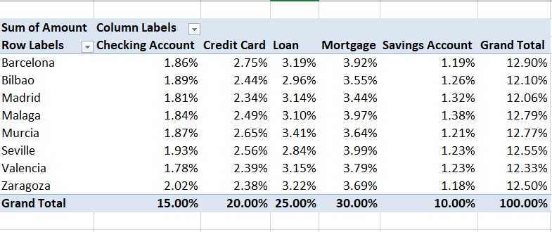
Pivot Tables
Your gateway to Power BI!
Pre-defined formulas by excel that perform specific calculations.
From This
To This
In 1 minute! (or less…)

Slide 43
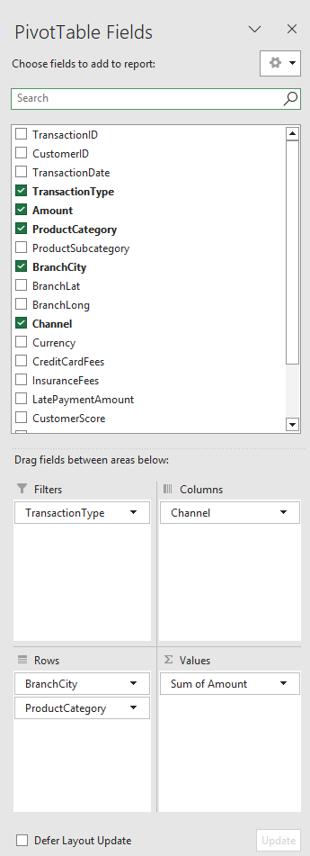
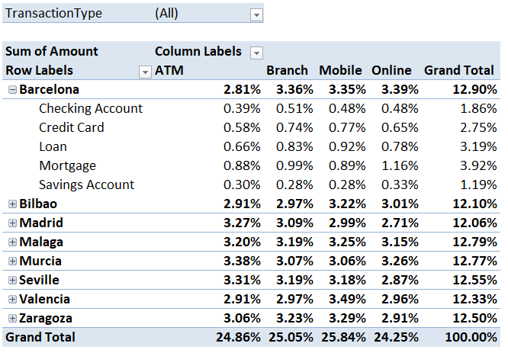
Components of A Pivot Table
Rows

Slide 44
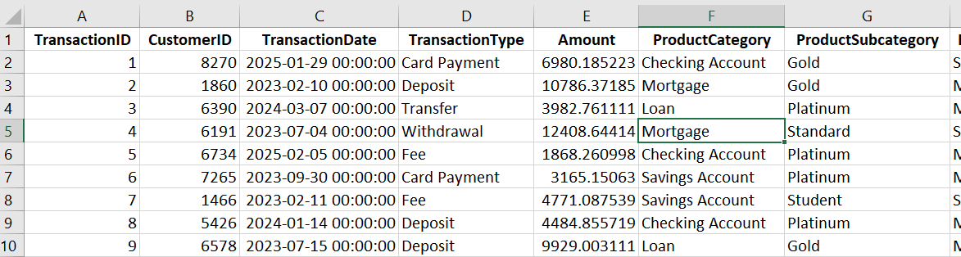
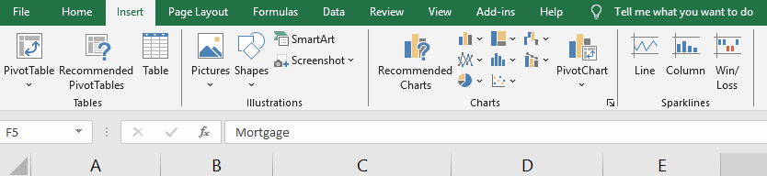
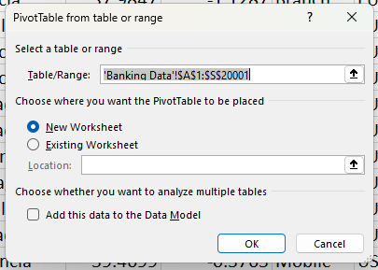
Building A Pivot Table
1. Select your data
Rows
2. Insert >> PivotTable
3. Choose Destination

Slide 45
Building A Pivot Table
4. Drag Fields to Areas
Rows
Customizing Value Fields
By Default, Excel often SUMs numbers and COUNTs text/numbers.
To change this: Click the dropdown arrow next to the field in the Values area > Value Field Settings.
Choose Sum, Count, Average, Max, Min, etc.

Slide 46
Exercise 8 – Pivot Table
Task 1 – Create a new Pivot Table on a new worksheet.
Task 2 – Show the total Amount (in Values) for each Product Category (in Rows).
Task 3 – Modify the Pivot Table: Add Currency ( in Columns) area to see amount by Product Category and Currency.
Task 4 – Change the Amount in the Values area to show the Average Amount instead of the Sum.
Task 5 – Add BranchCity to the Filters area and filter the Pivot Table to show data only for a specific city – (e.g. Barcelona)

Slide 47








Common Excel Issues & Troubleshooting
Common Error Messages
Attempting to divide by zero (e.g., 5/0)
Typo in a function name ( =AVERAE() )
Formula contains a type mismatch (e.g., 100+”abc”)
Formula refers to a cell that is deleted
Lookup value not found
Column is too narrow to display the number
Not an error, but the reason for many

Slide 48
Session 4 Recap
Congratulations! You have obtained 1 ingredient in the analyst recipe.
We have built Pivot Tables to accelerate data aggregation and analysis.
We learned to Troubleshoot Common Issues and understand Excel error messages.

Slide 49
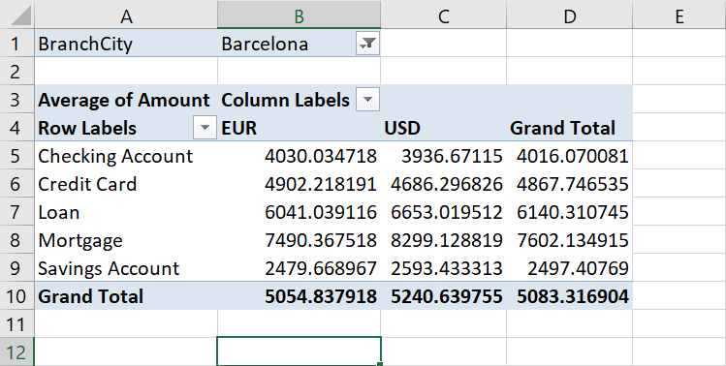
Session 4 Recap
Started from here…
Now we are here…

Slide 50
“
“Exceptional results almost exclusively happen when you work hard on an area where you have some natural aptitude. Play to your strengths”
James Clear

